Slide 1

NCFE Level 2 Interactive Media Presentation
Kirin Harrington - 2022

Slide 2
Introduction
The client
The client for this project was Kelham island museum, a museum celebrating the industrial history of Sheffield and its part in the manufacturing of steel. They have tasked me with creating an interactive element to enhance the experience of visiting their museum, while educating visitors about exhibits or the history of the museum.
The product
I have created a virtual reality experience, which lets the user to walk around and learn more about certain machines used in the manufacturing of steel, allowing them to see the machines up close and interact with them, alongside also having the option to read about them and their uses.

Slide 3
Contents
Title page
Introduction
Contents
Components of the project
Blender – An introduction
Blender - Evidence
Unity – An introduction
Unity - Evidence
Visual Studio Code – An introduction
Visual Studio Code - Evidence
The finished product

Slide 4




Components of the project
To create this interactive media product I had to make use of a large variety of tools and software, including things like Blender, Unity, and Visual studio code
Notes:
Explain what each piece of software does, Unity as a 3d game development environment, using objects and scripts to portray scenes in 3d space, Blender is software which allows the user to create professional 3d objects and render them with lighting and specific camera angles, Visual Studio Code is a code environment which allows you to write code in a great many languages and gives you useful addons such as line numbers and an autocorrect feature.

Slide 5
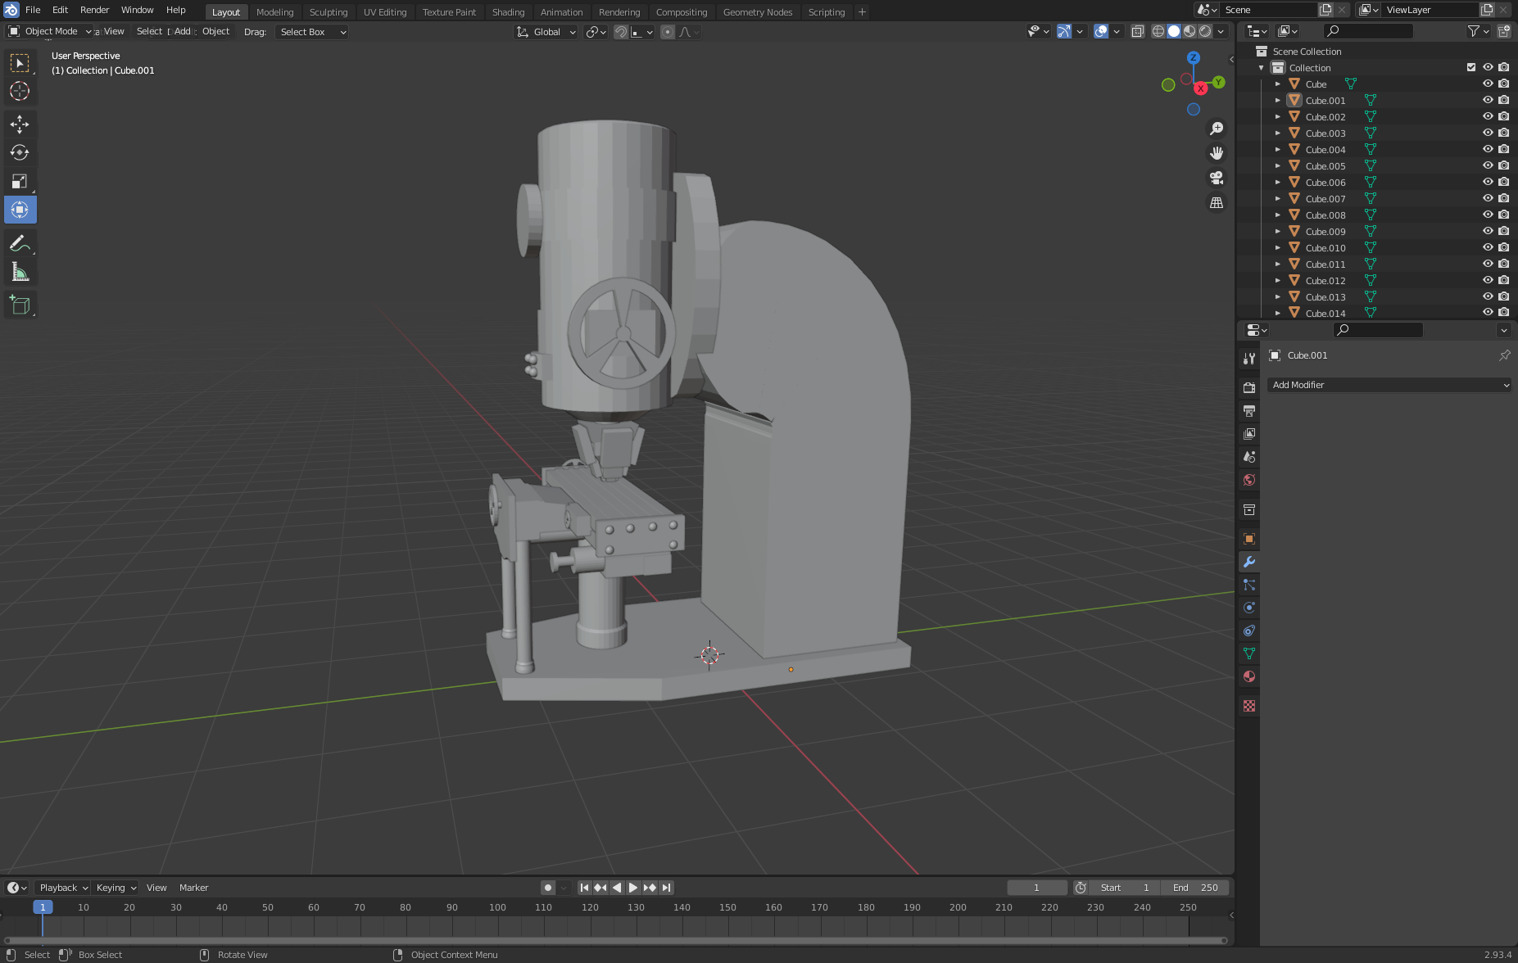
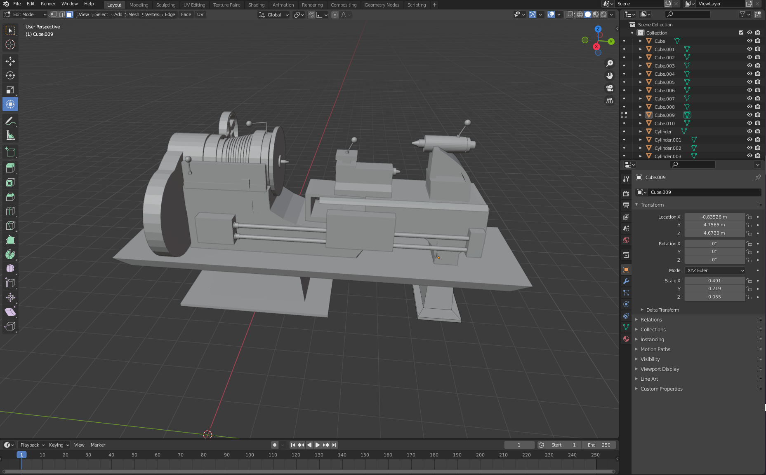
Blender – an introduction
Blender is a free and open-source 3D development software that I used extensively throughout my Interactive media product.
I used it to create models of machines that are used commonly in the steel manufacturing process.
Notes:
Blender is a 3D computer graphics software toolset used for a variety of purposes, such as animated films, motion graphics, and computer games, it has a vast variety of features including modeling, texturing, lighting, animation, and other very useful tools such as being able to simulate fluids and particle systems.

Slide 6
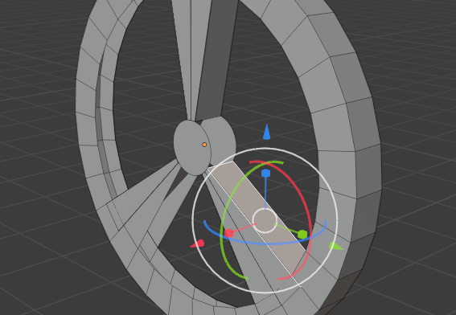
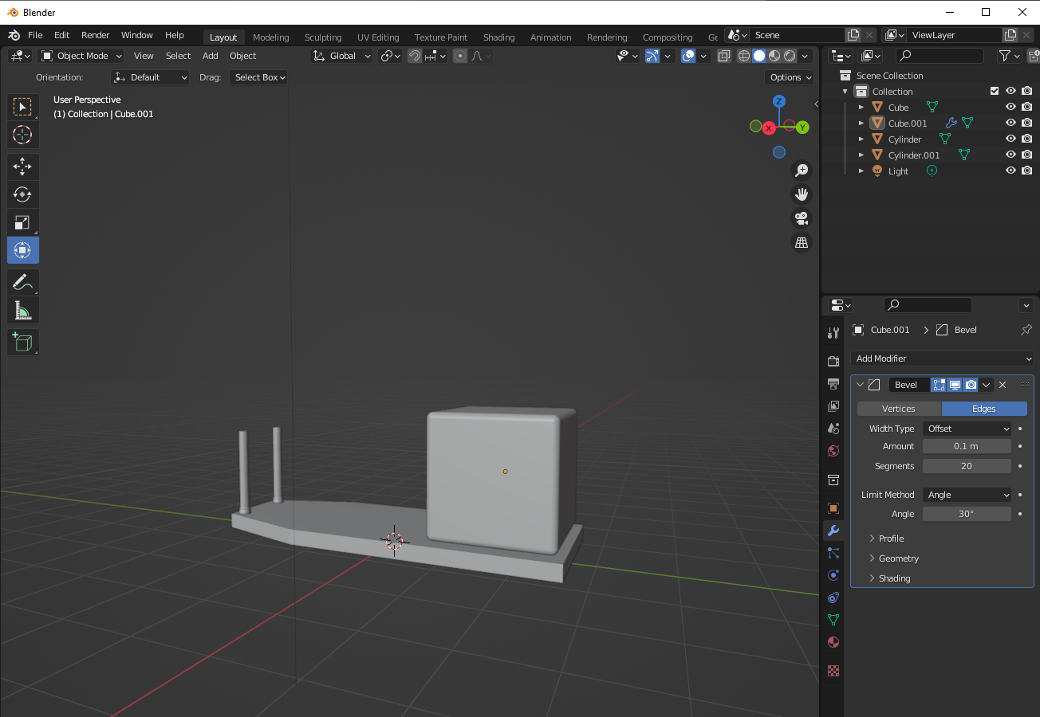
Blender
Skills shown in these images
Adding in new objects, to create more complex objects created from a large number of shapes
Transforming objects, involving moving, rotating and scaling objects
Deleting faces/vertices, to create more complex shapes and designs
Using modifiers, in these images I have used the “bevel” modifier to create rounded edges and improve the look of the object
Notes:
These images show me creating one of the assets for one of my models, the drill press, using the skills listed above.

Slide 7
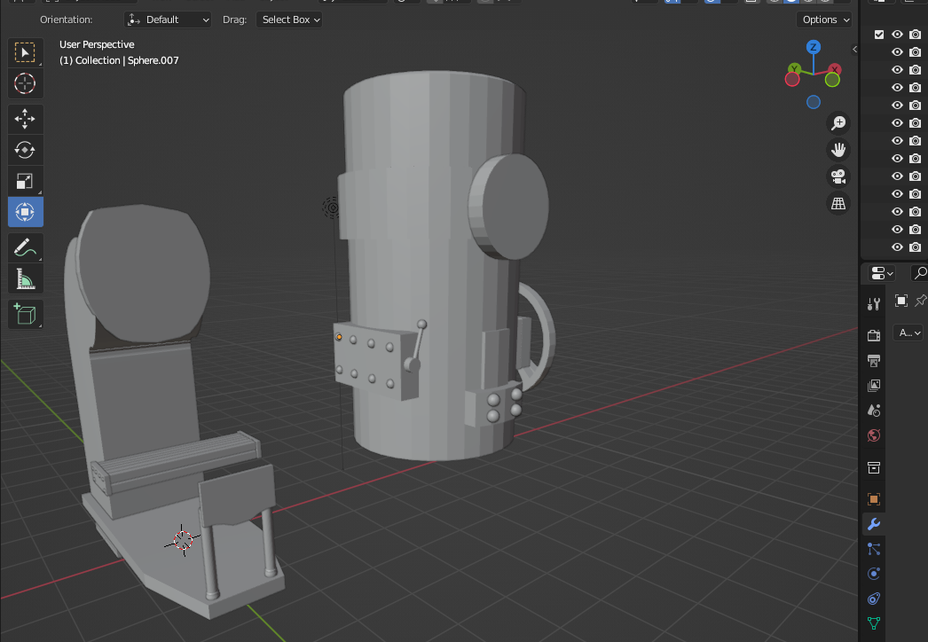
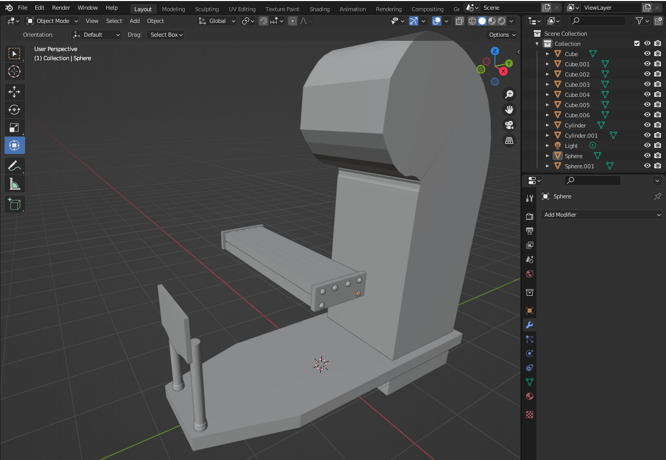
Blender
Skills shown in these images
Array modifier
Vertex selector
Duplicating objects
Extrude tool
Notes:
Describe the skills I am using in this slide, along with what modifiers are and how they work: Modifiers are features that can be applied to a mesh object to modify its appearance and vertices, to make drastic and complex changes, and greatly speed up the process of creating assets.

Slide 8
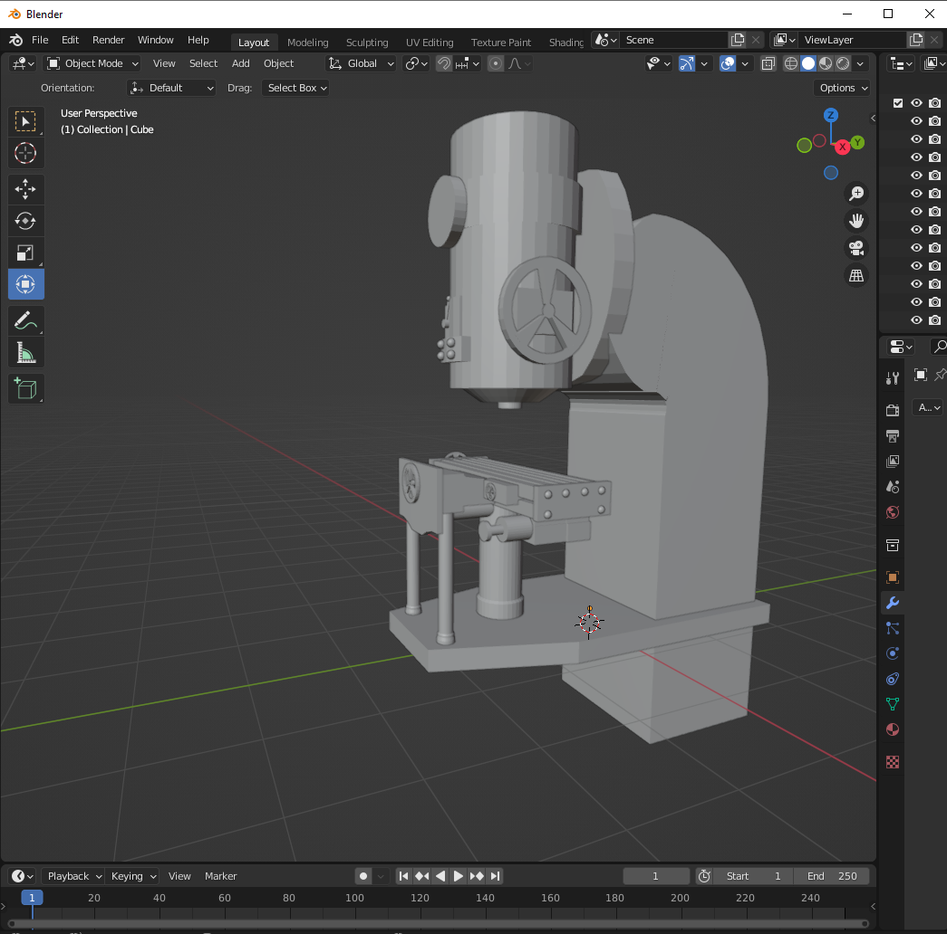
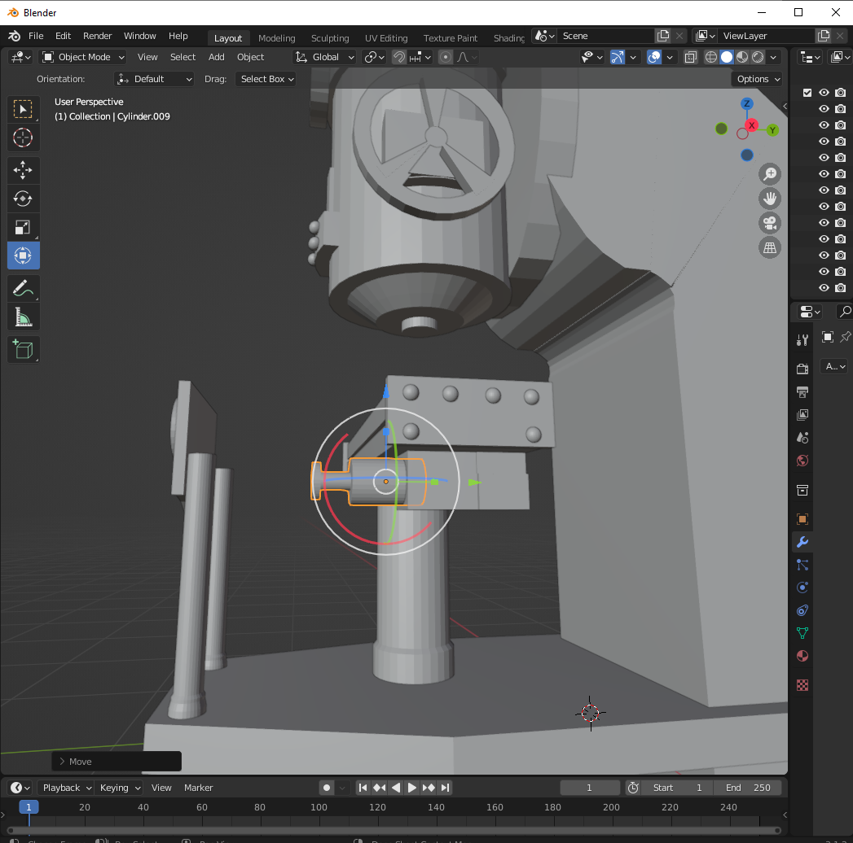
Blender
Skills shown in these images
Shade smooth tool
Inset faces tool
Mirror modifier
Notes:
These images show me finishing up my Blender model, and using the mirror modifier to make sure certain parts are perfectly symmetrical, creating a much more professional look

Slide 9
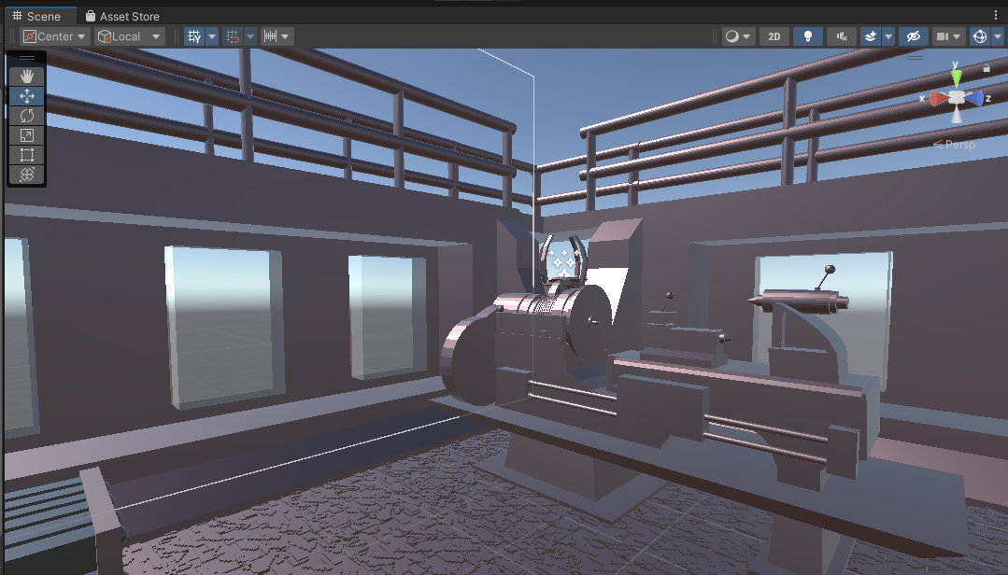
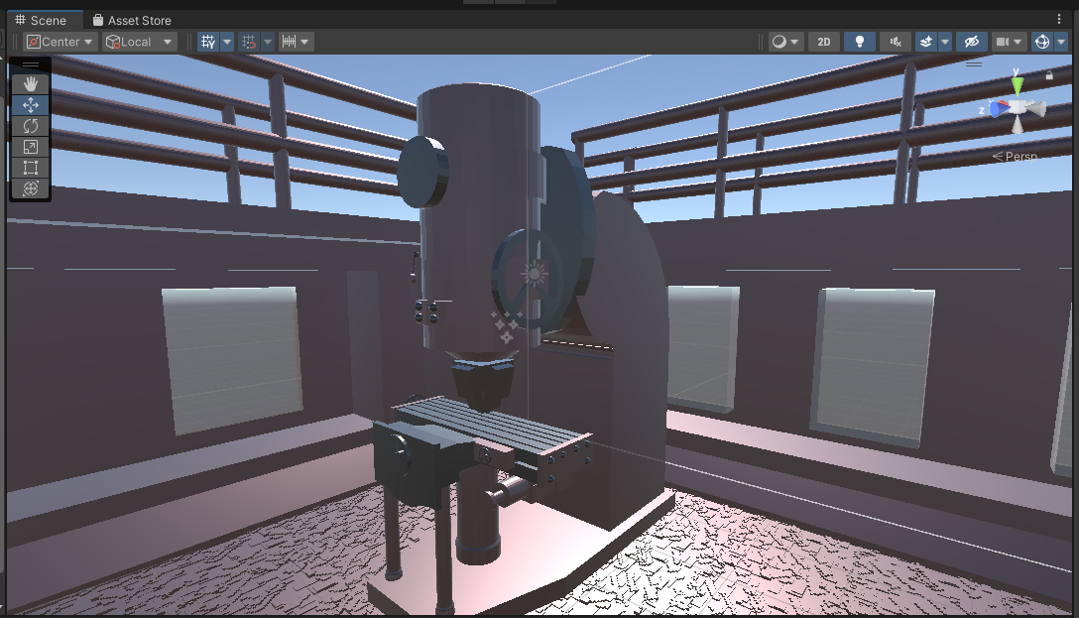
Unity – an introduction
Unity is a game engine that offers a powerful set of tools that can create 2D and 3D games, alongside supporting devices such as the Oculus Quest 2 for virtual reality development.
I used Unity for the bulk of my project, as I created my whole 3d environment inside of it.
Notes:
Unity is often used for creating games, but it can also be used for interactive simulations, training programs and other 3D applications, it is very flexible and therefore popular, and supports a wide variety of platforms for it to develop to

Slide 10
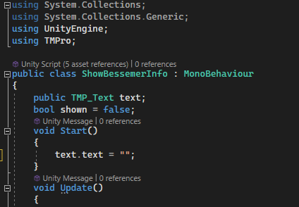
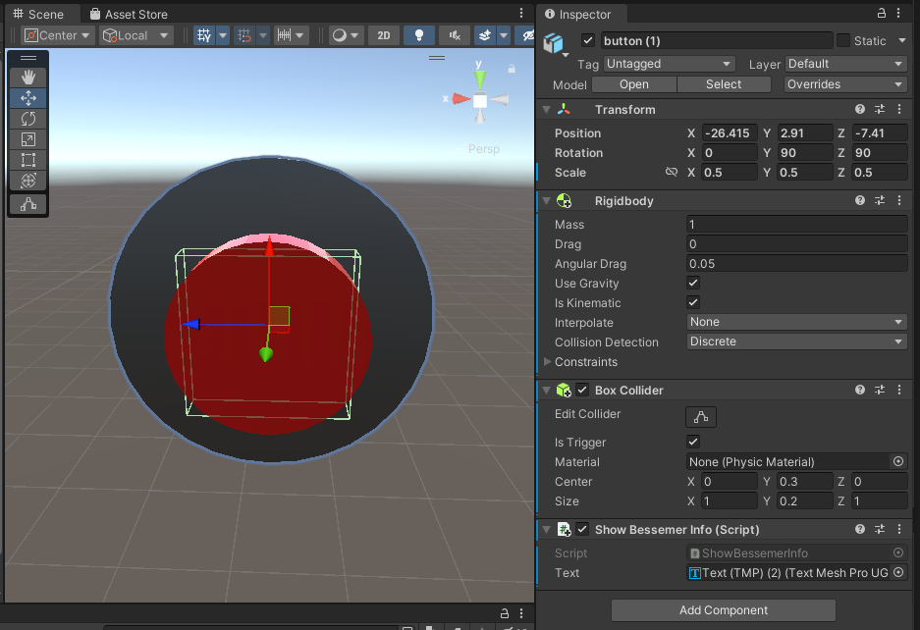
Unity
Skills shown in these images
Creating and editing a script
Detecting collisions
Adding 3d models to Unity
Using box colliders
Notes:
In these screenshots I am creating a button which can be activated by the user putting their hand onto the button, which will trigger an event, in this scenario, showing text, I did this through the use of box colliders and rigid bodies.

Slide 11
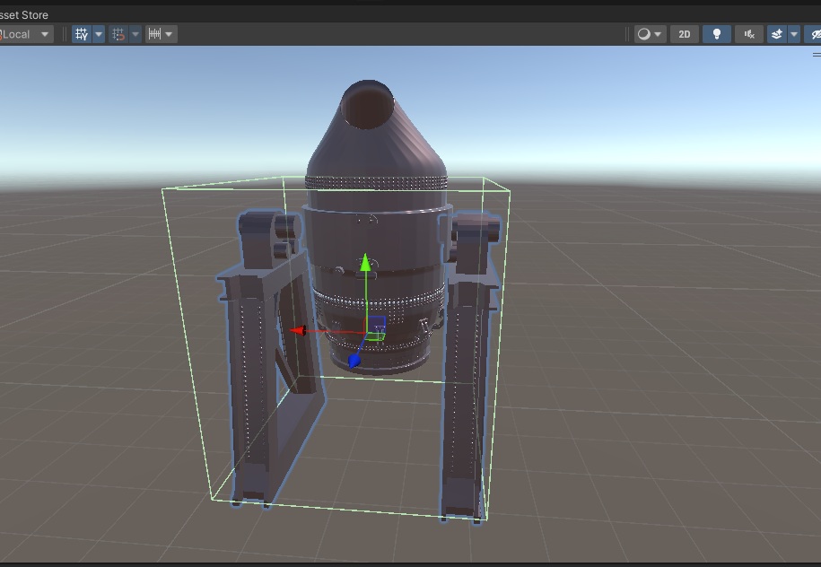
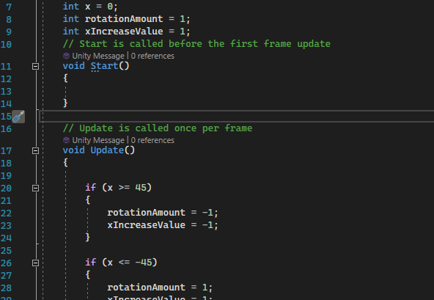
Unity
Skills shown in these images
Rotating objects on an axis
Texturing blender models in unity
Creating, editing and applying a script
Notes:
I used the button I had previously created to show text when pressed which related to the Blender model that was next to it to provide information about it while allowing the user to see it in person

Slide 12
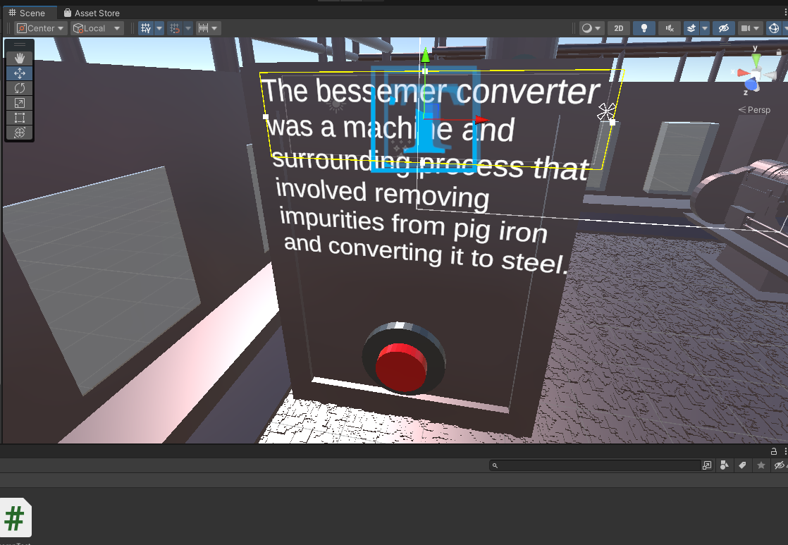
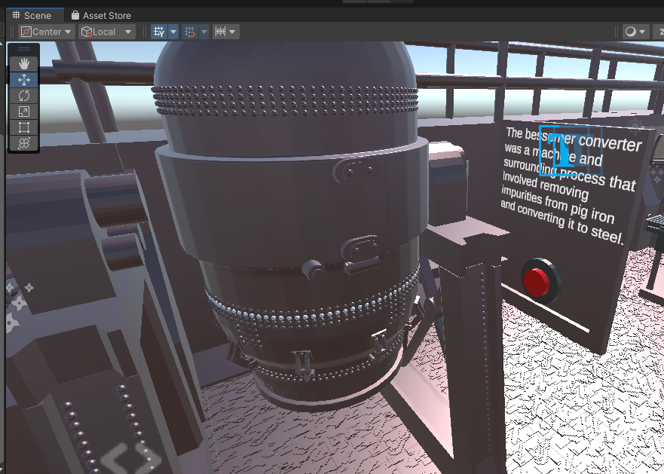
Unity
Skills shown in these images
Using textmesh pro
Creating a canvas and text
Changing the state of an object from a script
Notes:
I used the button I had previously created to show text when pressed which related to the Blender model that was next to it to provide information about it while allowing the user to see it in person

Slide 13
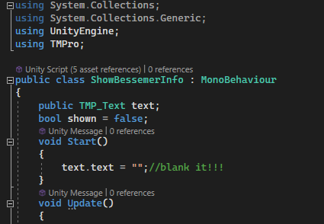
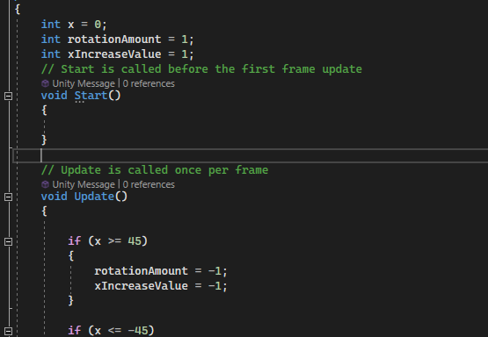
Visual Studio code – an introduction
Visual studio code (commonly referred to as vscode) is an open-source code editor that works with a variety of languages, and provides useful tools such as line numbers and an autocorrect feature
Notes:
I didn’t have to use Visual Studio Code much during the creation of my project, as I only used it to create movement for the models and the function allowing the buttons I created to show and hide text, for those functions, however, it was invaluable.

Slide 14
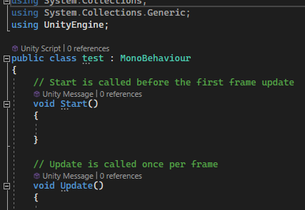
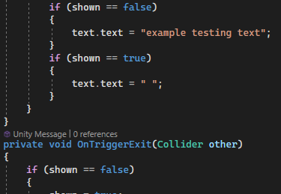
Visual Studio code
Skills shown in these images
Creating a new function for when the object collides with another
Using logic to show and hide text
Linking a text object with a c# script
Notes:
To make the text show and hide, it detects when the user pushes the button, to do this I had to attach this script to the button, and link the text object to it, in the code it detects if any object touches it, for instance, the users' hands, and then changes the text to make it appear

Slide 15
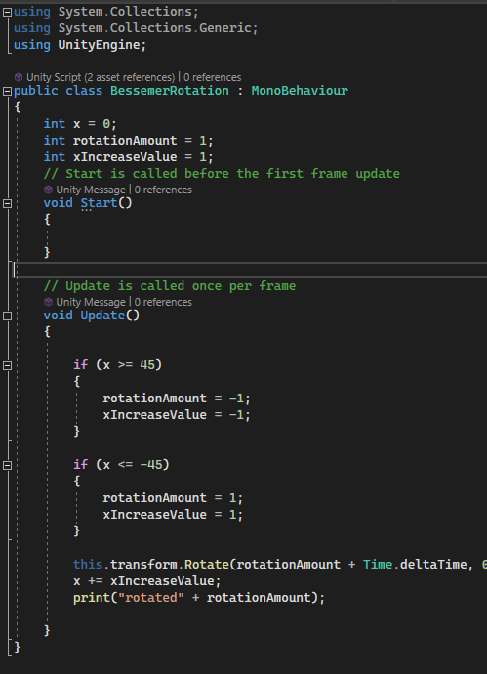
Visual Studio code
Skills shown in these images
Rotating an object on a fixed axis
Detecting when an object turns more than a certain amount
Printing information to the console for debugging
Notes:
I used this script to rotate the Bessemer converter model to simulate how it would move in real life, tilting from side to side, when it reached a certain distance in one direction, it flips and spins back the other way.

Slide 16
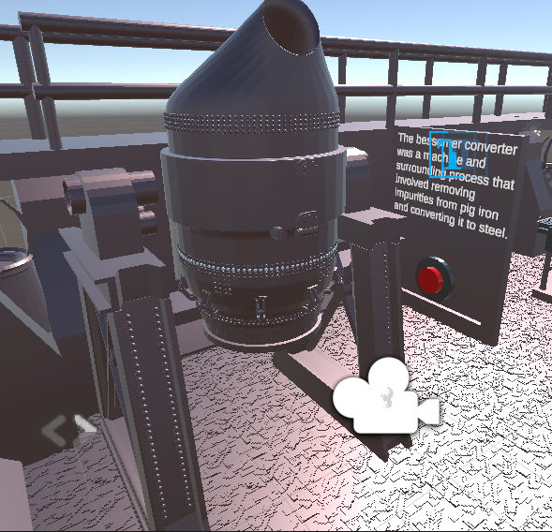
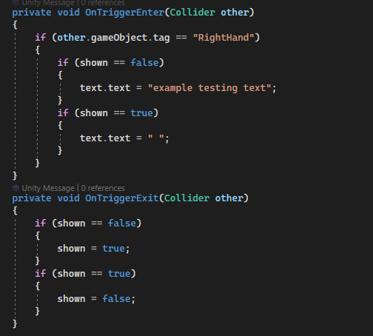
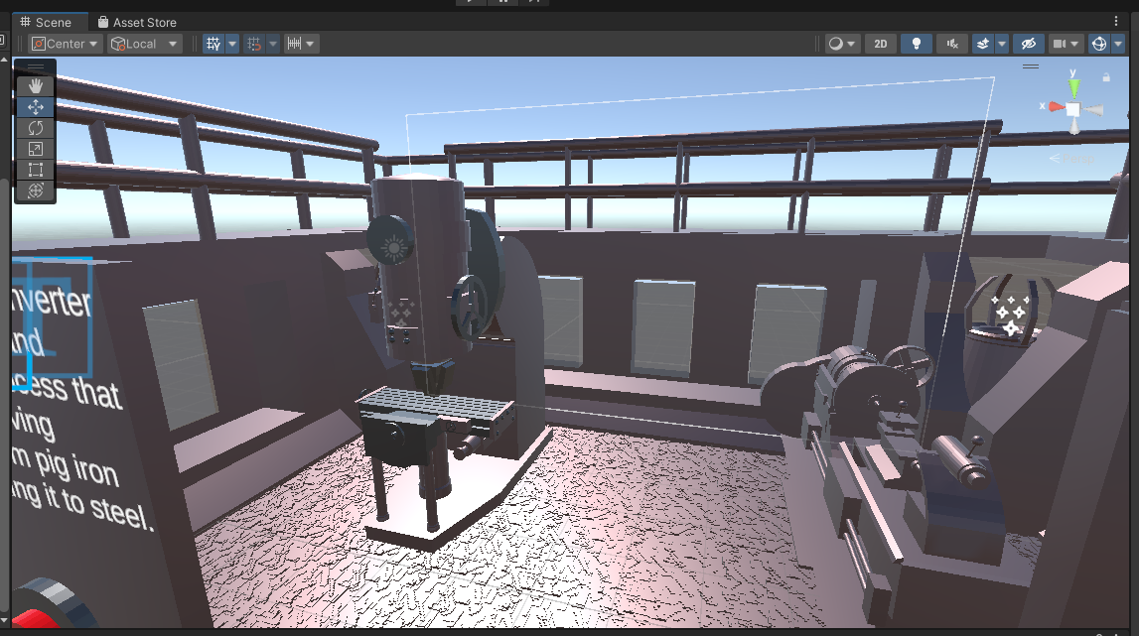
The finished project
A quick overview of the complete interactive media product I have created for Kelham island museum

Slide 17
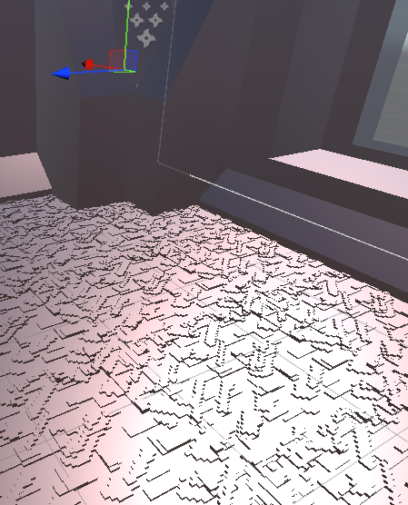
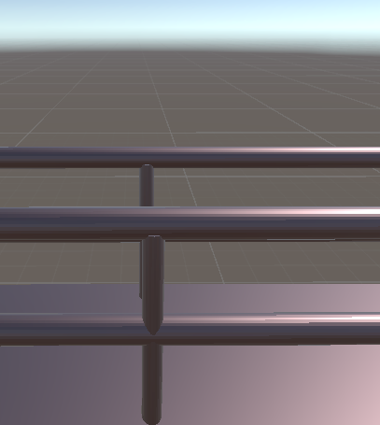
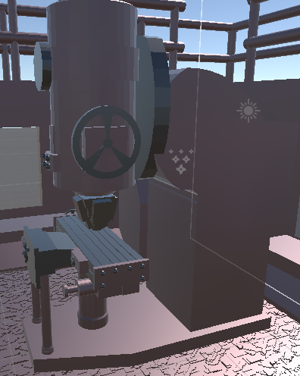




The theme/style
In keeping with Kelham island’s industrial style I tried to use a colour pallet of greys and blacks to fit the metal colours which are prevalent in their museum.
Notes:
I made sure to keep to the style of Kelham island museum to keep users immersed in the theme of the museum and keep them engaged in the service which the museum provides

Slide 18
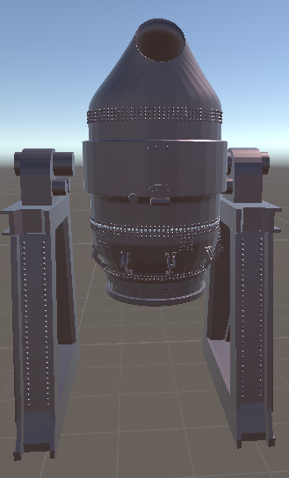
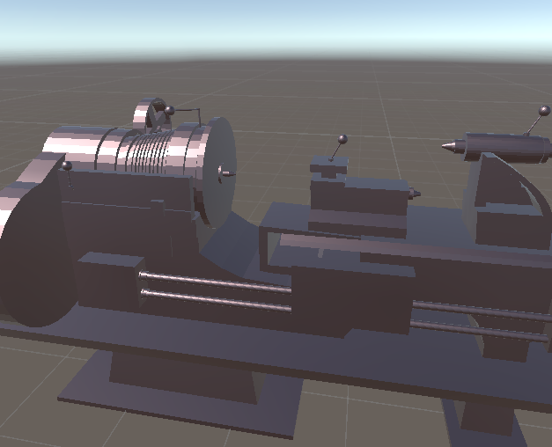
The models
For the models I decided to pick machines which were showcased inside the museum, such as the Bessemer converter, and other machines which are part of the history of steel manufacturing, and are still used today such as the Drill press
Notes:
Talk more in depth about the Lathe, Drill press and Bessemer converter and their function

Slide 19
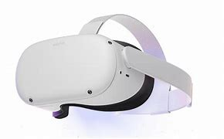
The platform
For the platform of my project I chose to use the oculus quest 2 as it is highly interactive and portable, and requires little to no maintenance
Notes:
Talk about the wide range of ages the oculus quest 2 can target, and other advantages such as being able to run on battery power for hours and hours, and taking up basically no space

Slide 20

Thank You!
Kirin Harrington – utc olp
kirin@twosmallpeople.co.uk

